Slide 1

CSE 209- Database Systems
Chapter-3
Farhana Akter Sunny
farhana@cse.green.edu.bd
Notes:
The slides for this text are organized into chapters. This lecture covers Chapter 1.
Chapter 1: Introduction to Database Systems
Chapter 2: The Entity-Relationship Model
Chapter 3: The Relational Model
Chapter 4 (Part A): Relational Algebra
Chapter 4 (Part B): Relational Calculus
Chapter 5: SQL: Queries, Programming, Triggers
Chapter 6: Query-by-Example (QBE)
Chapter 7: Storing Data: Disks and Files
Chapter 8: File Organizations and Indexing
Chapter 9: Tree-Structured Indexing
Chapter 10: Hash-Based Indexing
Chapter 11: External Sorting
Chapter 12 (Part A): Evaluation of Relational Operators
Chapter 12 (Part B): Evaluation of Relational Operators: Other Techniques
Chapter 13: Introduction to Query Optimization
Chapter 14: A Typical Relational Optimizer
Chapter 15: Schema Refinement and Normal Forms
Chapter 16 (Part A): Physical Database Design
Chapter 16 (Part B): Database Tuning
Chapter 17: Security
Chapter 18: Transaction Management Overview
Chapter 19: Concurrency Control
Chapter 20: Crash Recovery
Chapter 21: Parallel and Distributed Databases
Chapter 22: Internet Databases
Chapter 23: Decision Support
Chapter 24: Data Mining
Chapter 25: Object-Database Systems
Chapter 26: Spatial Data Management
Chapter 27: Deductive Databases
Chapter 28: Additional Topics

Slide 2
Data Types in SQL
char(n). Fixed length character string, with user-specified length n. can be from 0 to 255.
varchar(n). Variable length character strings, with user-specified maximum length n. can be from 0 to 65535.
int. Integer (a finite subset of the integers that is machine-dependent).
float(n). Floating point number, with user-specified precision of at least n digits.
float(p,d). Fixed point number, with user-specified precision of p digits, with d digits to the right of decimal point. (ex., numeric(3,1), allows 44.5 to be stores exactly, but not 444.5 or 0.32)
Date. A date. Format: YYYY-MM-DD. The supported range is from '1000-01-01' to '9999-12-31’
More are covered in https://www.w3schools.com/sql/sql_datatypes.asp

Slide 3
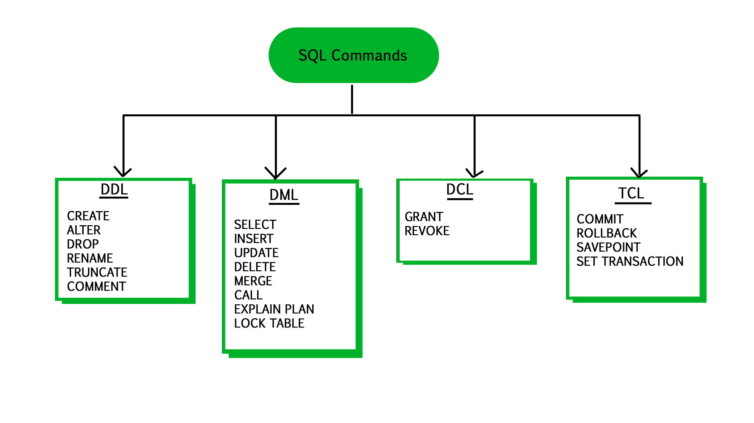
SQL Commands
SQL commands are mainly categorized into following categories:
DDL – Data Definition Language
DQl – Data Query Language
DML – Data Manipulation Language
DCL – Data Control Language
TCL – Transaction Control Language.

Slide 4
Create Table Construct
An SQL relation is defined using the create table command:
create table r (A₁ D₁, A₂ D₂, ..., A_{n} D_{n},
(integrity-constraint₁),
...,
(integrity-constraint_{k}))
  r is the name of the relation
  each A_{i} is an attribute name in the schema of relation r
  D_{i} is the data type of values in the domain of attribute A_{i}
Example:
create table instructor (
ID char(5),
name varchar(20),
dept_name varchar(20),
salary float(8,2))

Slide 5
Integrity Constraints in Create Table
not null
primary key (A₁, ..., A_{n} )
foreign key (A_{m}, ..., A_{n} ) references r
Example:
create table instructor (
ID char(5),
name varchar(20) not null,
dept_name varchar(20),
salary int,
primary key (ID),
foreign key (dept_name) references department);
primary key declaration on an attribute automatically ensures not null

Slide 6
And a Few More Relation Definitions
create table student (
ID varchar(5),
name varchar(20) not null,
dept_name varchar(20),
tot_cred float(3,1),
primary key (ID),
foreign key (dept_name) references department);
create table takes (
ID varchar(5),
course_id varchar(8),
sec_id varchar(8),
semester varchar(6),
year int
grade varchar(2),
primary key (ID, course_id, sec_id, semester, year) ,
foreign key (ID) references student,
foreign key (course_id, sec_id, semester, year) references section);
  Note: sec_id can be dropped from primary key above, to ensure a student cannot be registered for two sections of the same course in the same semester

Slide 7
And more still
create table course (
course_id varchar(8),
title varchar(50),
dept_name varchar(20),
credits int,
primary key (course_id),
foreign key (dept_name) references department);

Slide 8
Updates to tables
Insert
  insert into instructor values (‘10211’, ’Smith’, ’Biology’, 66000);
Delete
  Remove all tuples from the student relation
    delete from student
Drop Table
  drop table r
Alter
  alter table r add A D
    where A is the name of the attribute to be added to relation r and D is the domain of A.
    All exiting tuples in the relation are assigned null as the value for the new attribute.
  alter table r drop A
    where A is the name of an attribute of relation r
    Dropping of attributes not supported by many databases.

Slide 9
Basic Query Structure
A typical SQL query has the form:
select A₁, A₂, ..., A_{n}
from r₁, r₂, ..., r_{m}
where P
  A_{i} represents an attribute
  R_{i} represents a relation
  P is a predicate.
The result of an SQL query is a relation.
Notes:
2

Slide 10
The select Clause
The select clause lists the attributes desired in the result of a query
  corresponds to the projection operation of the relational algebra
Example: find the names of all instructors:
select name
from instructor
NOTE: SQL names are case insensitive (i.e., you may use upper- or lower-case letters.)
  E.g., Name ≡ NAME ≡ name
  Some people use upper case wherever we use bold font.
Notes:
3

Slide 11
The select Clause (Cont.)
SQL allows duplicates in relations as well as in query results.
To force the elimination of duplicates, insert the keyword distinct after select.
Find the department names of all instructors, and remove duplicates
select distinct dept_name
from instructor
The keyword all specifies that duplicates should not be removed.
select all dept_name
from instructor
Notes:
4

Slide 12
The select Clause (Cont.)
An asterisk in the select clause denotes “all attributes”
select *
from instructor
An attribute can be a literal with no from clause
select ‘437’
  Results is a table with one column and a single row with value “437”
  Can give the column a name using:
  select ‘437’ as FOO
Notes:
5

Slide 13
The select Clause (Cont.)
The select clause can contain arithmetic expressions involving the operation, +, –, ∗, and /, and operating on constants or attributes of tuples.
  The query:
  select ID, name, salary/12
  from instructor
  would return a relation that is the same as the instructor relation, except that the value of the attribute salary is divided by 12.
  Can rename “salary/12” using the as clause:
  select ID, name, salary/12 as monthly_salary
Notes:
5

Slide 14
The where Clause
The where clause specifies conditions that the result must satisfy
  Corresponds to the selection predicate of the relational algebra.
To find all instructors in Comp. Sci. dept
select name
from instructor
where dept_name = ‘Comp. Sci.'
Comparison results can be combined using the logical connectives and, or, and not
  To find all instructors in Comp. Sci. dept with salary > 80000
  select name
  from instructor
  where dept_name = ‘Comp. Sci.' and salary > 80000
Comparisons can be applied to results of arithmetic expressions.
Notes:
6

Slide 15
The from Clause
The from clause lists the relations involved in the query
  Corresponds to the Cartesian product operation of the relational algebra.
Find the Cartesian product instructor X teaches
select ∗
from instructor, teaches
  generates every possible instructor – teaches pair, with all attributes from both relations.
  For common attributes (e.g., ID), the attributes in the resulting table are renamed using the relation name (e.g., instructor.ID)
Cartesian product not very useful directly, but useful combined with where-clause condition (selection operation in relational algebra).
Notes:
8

Slide 16



Cartesian Product
instructor
teaches

Slide 17
Examples
Find the names of all instructors who have taught some course and the course_id
  select name, course_id
  from instructor , teaches
  where instructor.ID = teaches.ID
Find the names of all instructors in the Art department who have taught some course and the course_id
  select name, course_id
  from instructor , teaches
  where instructor.ID = teaches.ID and instructor. dept_name = ‘Art’
Notes:
9

Slide 18
The Rename Operation
The SQL allows renaming relations and attributes using the as clause:
old-name as new-name
Find the names of all instructors who have a higher salary greater than at least one instructor in ‘Comp. Sci’.
  select distinct T.name
  from instructor as T, instructor as S
  where T.salary > S.salary and S.dept_name = ‘Comp. Sci.’
Keyword as is optional and may be omitted
instructor as T ≡ instructor T
Notes:
9

Slide 19
String Operations
SQL includes a string-matching operator for comparisons on character strings. The operator like uses patterns that are described using two special characters:
  percent ( % ). The % character matches any substring.
  underscore ( _ ). The _ character matches any character.
Find the names of all instructors whose name includes the substring “dar”.
select name
from instructor
where name like '%dar%'
Match the string “100%”
like ‘100 \%' escape '\'
in that above we use backslash (\) as the escape character.

Slide 20
String Operations (Cont.)
Pattern matching examples:
  ‘Intro%’ matches any string beginning with “Intro”.
  ‘%Comp%’ matches any string containing “Comp” as a substring.
  ‘_ _ _’ matches any string of exactly three characters.
  ‘_ _ _ %’ matches any string of at least three characters.
SQL supports a variety of string operations such as
  concatenation (using “||”)
  converting from upper to lower case (and vice versa)
  finding string length, extracting substrings, etc.

Slide 21
Ordering the Display of Tuples
List in alphabetic order the names of all instructors
select distinct name
from instructor
order by name
We may specify desc for descending order or asc for ascending order, for each attribute; ascending order is the default.
  Example: order by name desc
Can sort on multiple attributes
  Example: order by dept_name, name

Slide 22
Where Clause Predicates
SQL includes a between comparison operator
Example: Find the names of all instructors with salary between $90,000 and $100,000 (that is, ≥ $90,000 and ≤ $100,000)
  select name
  from instructor
  where salary between 90000 and 100000
Tuple comparison: Find the instructor names and the courses they taught for all instructors in the Biology department who have taught some course.
  select name, course_id
  from instructor, teaches
  where (instructor.ID, dept_name) = (teaches.ID, ’Biology’);
  OR
  select name, course_id
  from instructor, teaches
  where instructor.ID = teaches.ID and dept_name= ’Biology’;
Notes:
7

Slide 23
Set Operations
Find courses that ran in Fall 2009 or in Spring 2010
(select course_id from section where sem = ‘Fall’ and year = 2009)
union
(select course_id from section where sem = ‘Spring’ and year = 2010)
Find courses that ran in Fall 2009 and in Spring 2010
(select course_id from section where sem = ‘Fall’ and year = 2009)
intersect
(select course_id from section where sem = ‘Spring’ and year = 2010)
Find courses that ran in Fall 2009 but not in Spring 2010
(select course_id from section where sem = ‘Fall’ and year = 2009)
except
(select course_id from section where sem = ‘Spring’ and year = 2010)

Slide 24
Set Operations (Cont.)
Set operations union, intersect, and except
  Each of the above operations automatically eliminates duplicates
To retain all duplicates use the corresponding multiset versions union all, intersect all and except all.

Slide 25
Null Values
It is possible for tuples to have a null value, denoted by null, for some of their attributes
null signifies an unknown value or that a value does not exist.
The result of any arithmetic expression involving null is null
  Example: 5 + null returns null
The predicate is null can be used to check for null values.
  Example: Find all instructors whose salary is null.
select name
from instructor
where salary is null

Slide 26
AND, OR, NOT
The WHERE clause can be combined with AND, OR, and NOT operators.
The AND and OR operators are used to filter records based on more than one condition:
The AND operator displays a record if all the conditions separated by AND are TRUE.
The OR operator displays a record if any of the conditions separated by OR is TRUE.
The NOT operator displays a record if the condition(s) is NOT TRUE.
SELECT * FROM Customers
WHERE Country='Germany' AND City='Berlin';
SELECT * FROM Customers
WHERE City='Berlin' OR City='München';
SELECT * FROM Customers
WHERE NOT Country='Germany';

Slide 27
Combining AND, OR, NOT
You can also combine the AND, OR and NOT operators.
SELECT * FROM Customers
WHERE Country='Germany' AND (City='Berlin' OR City='München');
SELECT * FROM Customers
WHERE NOT Country='Germany' AND NOT Country='USA';

Slide 28
Aggregate Functions
These functions operate on the multiset of values of a column of a relation, and return a value
avg: average value
min: minimum value
max: maximum value
sum: sum of values
count: number of values

Slide 29
Aggregate Functions (Cont.)
Find the average salary of instructors in the Computer Science department
  select avg (salary)
  from instructor
  where dept_name= ’Comp. Sci.’;
Find the total number of instructors who teach a course in the Spring 2010 semester
  select count (distinct ID)
  from teaches
  where semester = ’Spring’ and year = 2010;
Find the number of tuples in the course relation
  select count (*)
  from course;

Slide 30


Aggregate Functions – Group By
Find the average salary of instructors in each department
  select dept_name, avg (salary) as avg_salary
  from instructor
  group by dept_name;
avg_salary

Slide 31
Aggregation (Cont.)
Attributes in select clause outside of aggregate functions must appear in group by list
  /* erroneous query */
  select dept_name, ID, avg (salary)
  from instructor
  group by dept_name;

Slide 32
Aggregate Functions – Having Clause
Find the names and average salaries of all departments whose average salary is greater than 42000
select dept_name, avg (salary)
from instructor
group by dept_name
having avg (salary) > 42000;
Note: predicates in the having clause are applied after the
formation of groups whereas predicates in the where
clause are applied before forming groups

Slide 33
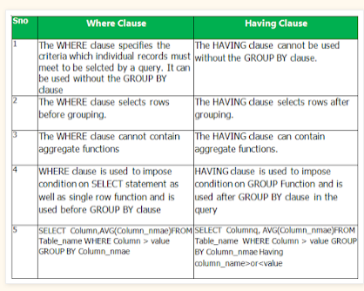


Slide 34
Nested Subqueries
SQL provides a mechanism for the nesting of subqueries. A subquery is a select-from-where expression that is nested within another query.
The nesting can be done in the following SQL query
select A₁, A₂, ..., A_{n}
from r₁, r₂, ..., r_{m}
where P
as follows:
  A_{i} can be replaced be a subquery that generates a single value.
  r_{i} can be replaced by any valid subquery
  P can be replaced with an expression of the form:
  B <operation> (subquery)
  Where B is an attribute and <operation> to be defined later.

Slide 35
Subqueries in the Where Clause

Slide 36
Subqueries in the Where Clause
A common use of subqueries is to perform tests:
  For set membership
  For set comparisons
  For set cardinality.

Slide 37
Set Membership
Find courses offered in Fall 2009 and in Spring 2010
select distinct course_id
from section
where semester = ’Fall’ and year= 2009 and
course_id in (select course_id
from section
where semester = ’Spring’ and year= 2010);
Find courses offered in Fall 2009 but not in Spring 2010
select distinct course_id
from section
where semester = ’Fall’ and year= 2009 and
course_id not in (select course_id
from section
where semester = ’Spring’ and year= 2010);

Slide 38
Set Membership (Cont.)
Find the total number of (distinct) students who have taken course sections taught by the instructor with ID 10101
select count (distinct ID)
from takes
where (course_id, sec_id, semester, year) in
(select course_id, sec_id, semester, year
from teaches
where teaches.ID= 10101);
Note: Above query can be written in a much simpler manner.
The formulation above is simply to illustrate SQL features.

Slide 39
Set Comparison – “some” Clause
Find names of instructors with salary greater than that of some (at least one) instructor in the Biology department.
select distinct T.name
from instructor as T, instructor as S
where T.salary > S.salary and S.dept name = ’Biology’;
Same query using > some clause
select name
from instructor
where salary > some (select salary
from instructor
where dept name = ’Biology’);

Slide 40
Definition of “some” Clause
F <comp> some r ⇔ ∃ t ∈ r such that (F <comp> t )
Where <comp> can be: <, ≤, >, =, ≠
0
(5 < some
5
) = true
(read: 5 < some tuple in the relation)
6
0
(5 < some
5
) = false
0
(5 = some
) = true
5
0
(5 ≠ some
5
) = true (since 0 ≠ 5)
(= some) ≡ in
However, (≠ some) ≡ not in

Slide 41
Set Comparison – “all” Clause
Find the names of all instructors whose salary is greater than the salary of all instructors in the Biology department.
select name
from instructor
where salary > all (select salary
from instructor
where dept name = ’Biology’);

Slide 42
Find the departments that have the highest average salary
select dept name
from instructor
group by dept name
having avg (salary) >= all (select avg (salary)
from instructor
group by dept name);
select dept_name from instructor group by dept_name having avg (salary) >= all (select avg (salary) from instructor group by dept_name)

Slide 43
Definition of “all” Clause
F <comp> all r ⇔ ∀ t ∈ r (F <comp> t)
0
(5 < all
5
) = false
6
6
(5 < all
) = true
10
4
(5 = all
) = false
5
4
(5 ≠ all
) = true (since 5 ≠ 4 and 5 ≠ 6)
6
(≠ all) ≡ not in
However, (= all) ≡ in

Slide 44
Deletion
Delete all instructors
delete from instructor
Delete all instructors from the Finance department
delete from instructor
where dept_name= ’Finance’;
Delete all tuples in the instructor relation for those instructors associated with a department located in the Watson building.
delete from instructor
where dept name in (select dept name
from department
where building = ’Watson’);

Slide 45
Deletion (Cont.)
Delete all instructors whose salary is less than the average salary of instructors
delete from instructor
where salary < (select avg (salary)
from instructor);
  Problem: as we delete tuples from deposit, the average salary changes
  Solution used in SQL:
  1. First, compute avg (salary) and find all tuples to delete
  2. Next, delete all tuples found above (without
  recomputing avg or retesting the tuples)

Slide 46
Insertion
Add a new tuple to course
insert into course
values (’CS-437’, ’Database Systems’, ’Comp. Sci.’, 4);
or equivalently
insert into course (course_id, title, dept_name, credits)
values (’CS-437’, ’Database Systems’, ’Comp. Sci.’, 4);
Add a new tuple to student with tot_creds set to null
insert into student
values (’3003’, ’Green’, ’Finance’, null);

Slide 47
Insertion (Cont.)
Add all instructors to the student relation with tot_creds set to 0
insert into student
select ID, name, dept_name, 0
from instructor
The select from where statement is evaluated fully before any of its results are inserted into the relation.
Otherwise queries like
insert into table1 select * from table1
would cause problem

Slide 48
Updates
Increase salaries of instructors whose salary is over $100,000 by 3%, and all others by a 5%
  Write two update statements:
  update instructor
  set salary = salary * 1.03
  where salary > 100000;
  update instructor
  set salary = salary * 1.05
  where salary <= 100000;
  The order is important
  Can be done better using the case statement (next slide)

Slide 49
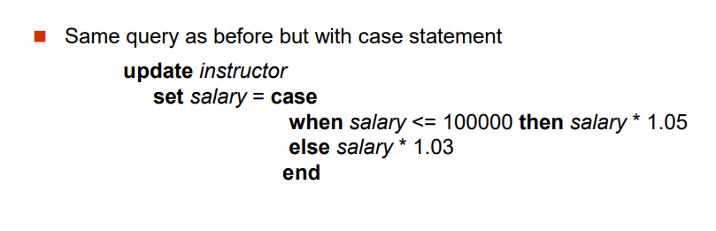
Case Statement for Conditional Updates

Slide 50
End of Chapter 3

